Slide 1
Erin’s Law
FMS Student Presentation
2018-2019
Presented by: FMS School Counseling Department

Slide 2
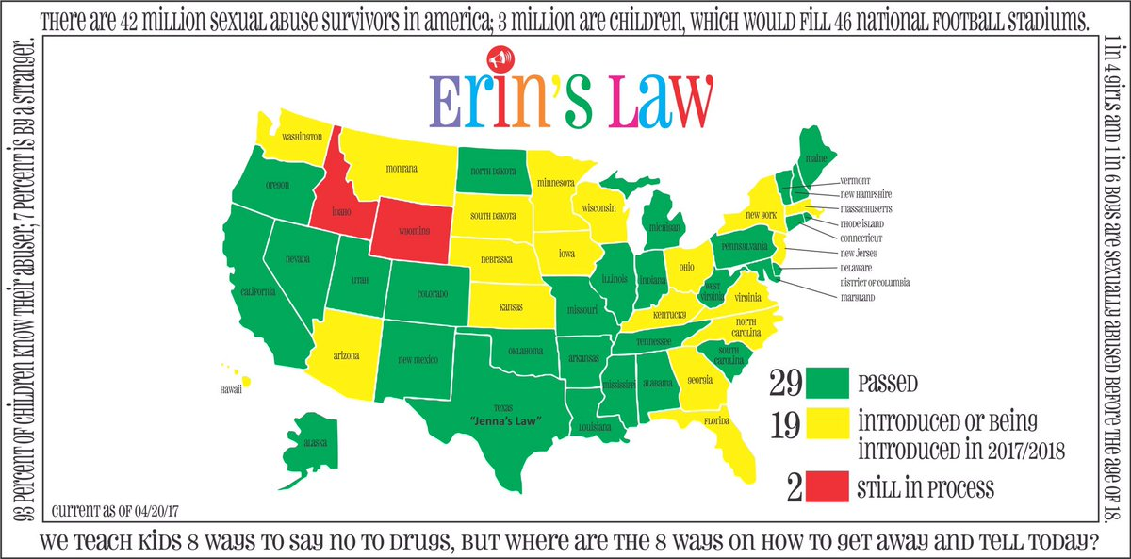

Slide 3
Erin’s Law is named after childhood sexual assault survivor, author, speaker and activist Erin Merryn. After Erin introduced the legislation in her home state of Illinois, the bill was named “Erin’s Law” after her by legislators and it has caught on nationwide
Breaking the Silence PSA
Watch video

Slide 4
“Erin’s Law” requires that all public schools in each state implement a prevention-oriented child sexual abuse program which teaches: Students in grades pre-K–12th grade, age-appropriate techniques to recognize child sexual abuse and tell a trusted adult School personnel all about child sexual abuse Parents & guardians the warning signs of child sexual abuse, plus needed assistance, referral or resource information to support sexually abused children and their families

Slide 5
What is sexual abuse?
It can be physical or can include the following:
Exposing or touching a child’s private parts or making the child expose or touch someone else’s private parts
Making a child watch or listen to sexual acts or showing them pornography
Inappropriately watching a child dress or use the bathroom
Talking to a child in sexually explicit ways in person, by phone, by text, or on the internet

Slide 6
Three kinds of touches
Safe touches. These are touches that keep children safe and are good for them, and that make children feel cared for and important. Safe touches can include hugging, pats on the back, and an arm around the shoulder. Safe touches can also include touches that might hurt, such as removing a splinter.
Unsafe touches. These are touches that hurt children’s bodies or feelings (for example, hitting, pushing, pinching, and kicking). These kinds of touches are not okay. Another kind of unsafe touch is when someone asks you to touch their private body parts or touches you on your private body parts and it’s not to keep you healthy.
Unwanted touches. These are touches that might be safe but that a child doesn’t want from that person or at that moment. It’s okay to say no to an unwanted touch, even if it’s from a familiar person.

Slide 7
You are the boss of your body
You are in control of who touches your bodies and how.
You can use your voice and body to stop unsafe and unwanted touches.
Tell a trusted adult immediately if you feel unsafe or uncomfortable around someone.

Slide 8
What do we know about sexual abuse?
It’s estimated that there are 42 million survivors of sexual abuse in the United States--3 million of those are still children
93% of the time, the child knows the abuser
9 out of 10 victims never disclose

Slide 9
Misconceptions
Children aren’t really in danger
Educating children puts ideas in their heads
Educating children will scare them
Personal body safety includes lessons on sex education
My child is too young to learn about personal body safety
Kids make this stuff up

Slide 10
If you’re a student that has experienced any form of abuse you are not alone and this is not your fault. You have nothing to be ashamed of.

Slide 11
What do I do if I have been sexually abused?
If you have not told anyone you need to tell immediately a safe trusted adult. Think of people in your life that care about you and you trust. That could be a parent, teacher, relative, school counselor or principal, someone in your church, family friend, or coach.
If it is too difficult to talk about it you can write a letter explain what has or is happening to you and give it to a trusted adult.
You can also immediately contact police by calling 911. If you report your abuse and it does not stop report, it to another adult in your life.
Do not keep it a secret even if you are threatened and told no one will believe you. You will be believed.

Slide 12
What do I do if someone else tells me they have been sexually abused?
If you have a friend or family member that has told you that
they are being abused and have told you not to tell anyone
you must not keep it a secret and report it to
a trusted adult immediately.
They may be up upset at first but they will not stay mad
at you forever.

Slide 13
Safe Secrets ex. A Safe Secret is one that will eventually be told and will make everyone smile-like a surprise party or the gender of a baby-to-be. vs. Unsafe secrets An Unsafe Secret is one that makes you feel confused, threatened, unsafe, or icky and is one that you are told not to tell.

Slide 14
Some Possible Resources
National Sexual Assault hotline at 1-800-656-4673
You can talk to someone online at https://www.rainn.org. This is a free service.
Get help. Talking about your abuse is difficult however it is the best thing for you in healing your life. Keeping it in will only slow the process with moving forward.

